Slide 1

Introduction to Computer Science: Programming Methodology
Tutorial 14
tree
Frederick Khasanto
122040014
7 December 2023

Slide 2
Definition of Binary Tree Class
Refer to the LBTree.py file.
The nodes in the binary tree you define is of Node class defined by yourselves. Node class has four data fields, one(element) store the value of the node and three references(or pointers) store parent, left child and right child node respectively(or equivalently their addresses).
The binary tree has two data fields, its root and its size(the total number of nodes).

Slide 3
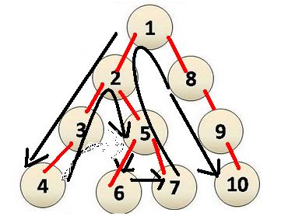
Depth First Search
Refer to the DFS.py file.
Depth-first search (DFS) is a fundamental algorithm for traversing or searching tree data structures.
One starts at the root and explores as deep as possible along each branch before backtracking.

Slide 4
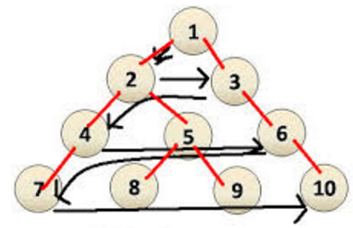
Breadth First Search
Refer to the BFS.py file.
Breadth-first search (BFS) is another very important algorithm for traversing or searching tree data structures.
Starts at the root and we visit all the positions at depth d before we visit the positions at depth d +1.

Slide 5
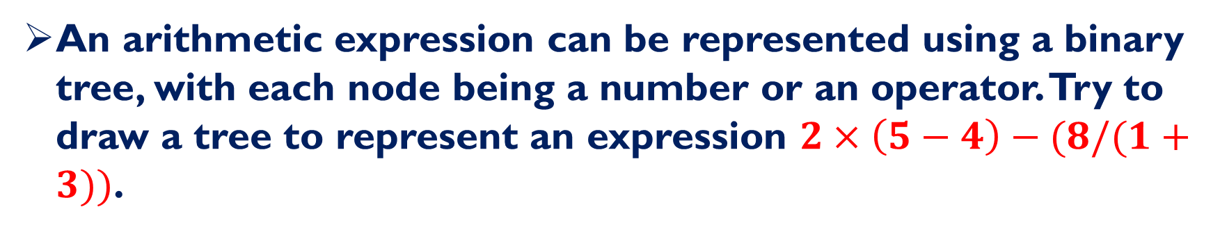
Q1: Represent an Expression
An arithmetic expression can be represented using a binary tree, with each node being a number or an operator. Try to draw a tree to represent an expression $2×\left(5−4\right)−(8/(1+3))$.

Slide 6
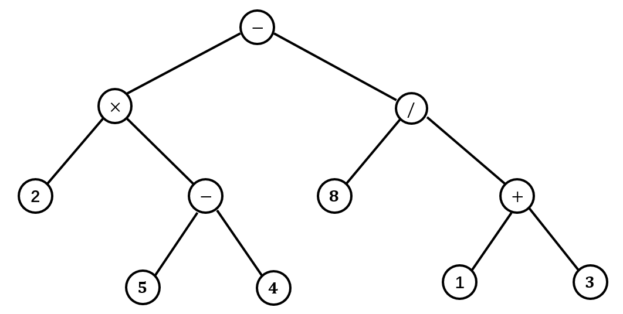
Q1: Answer

Slide 7
Q2: Create a Tree Object
Using the definition of binary tree class, create an object of that class, with value of each node equal to that in the binary tree you draw in Q1.

Slide 8
Q3: Depth First Search
i) Apply the Depth First Search algorithm to the tree you create in Q2, and check the order of elements in the tree printed out.
ii) Modify the Depth First Search program a little bit, define a function that is able to evaluate an expression represented by a binary tree.
iii) You can try i) ii) using Breadth First Search algorithm.

Slide 9
Q4: Path Length of a Tree-I
The path length of a tree T is the sum of the depths of all positions in T. Describe a linear time method for computing the path length of a tree T.

Slide 10
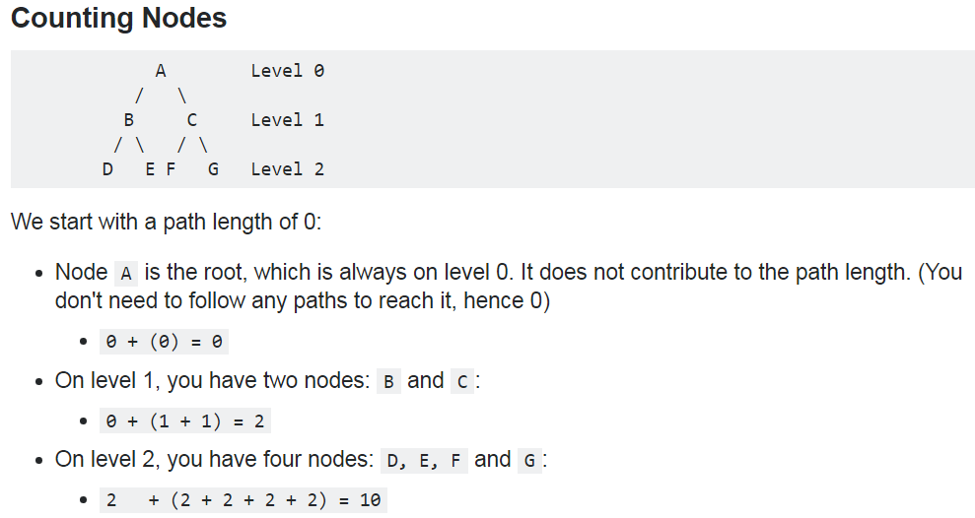
Q4: Path Length of a Tree-II

Slide 11
Final review!
Try to answer these questions and test yourself!

Slide 12
Single-choice questions
Which of the following is NOT a high-level programming language?
Java language
Assembly language
Python
C++ language
Binary number 11001101.001 and hexadecimal number 45E.8 equal to decimal numbers:
205.125 and 1118.5
205.125 and 1119.5
153.25 and 1118.5
153.25 and 1119.5

Slide 13
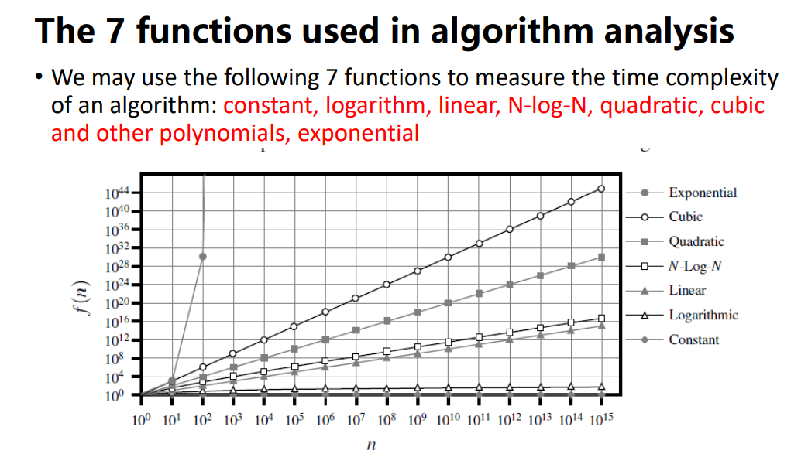
Single-choice questions
3. Order the following time complexities from fast to slow: I. 2ⁿ II. log(n) III. nlog(n) IV. n³ V. n VI. n²
I, II, III, IV, V, VI
V, II, III, I VI, IV
III, II, V, VI, IV, I
II, V, III, VI, IV, I

Slide 14
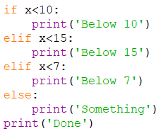
Single-choice questions
4. Concerning the following program, which of the following statements is incorrect?
print(‘Below 10’) will be executed when x = 8.
print(‘Below 7’) will be executed when x = 1.
print(‘Below 15’) will be executed when x = 12.
print(‘Something’) will be executed when x = 20.

Slide 15
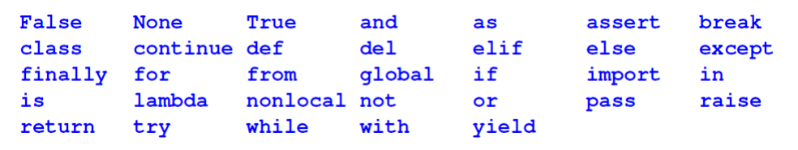
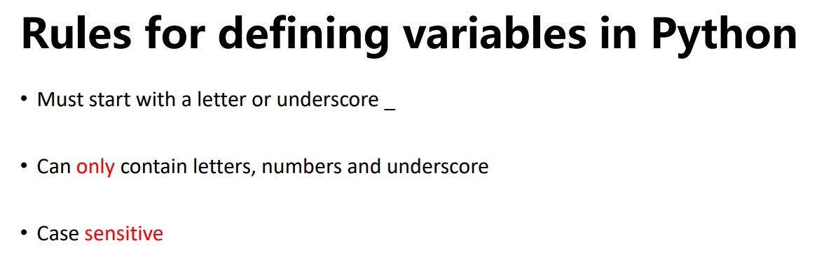
Multiple-choice questions
5. Which of the following is/are the python reserved word?
True
del
assertation
break
6. Which of the following is/are a legal variable name/s?
Myvar
_myvar
My_var
My-var

Slide 16
Multiple-choice questions
7. Concerning algorithm analysis, which of the following statement/s is/are correct?
Function 5𝑛⁴ + 6𝑛³ + 2𝑛log(𝑛) + 2𝑛 + 2 is O(𝑛log(𝑛)).
The big-Oh notation allows us to say that a function f(n) is less than or equal to another function g(n) up to a constant factor when n is large enough.
When we analyze an algorithm, we are usually interested at its average performance regardless of the input size.
The big-Oh notation can be used to characterize the running time of an algorithm in the asymptotic sense.

Slide 17
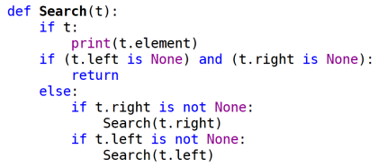
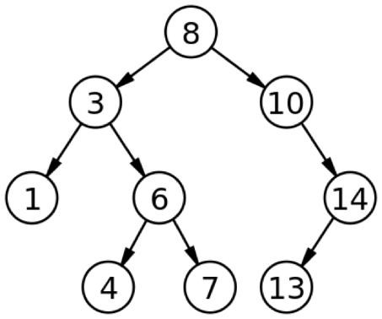
Open Questions
8. Concerning the following program, and assume that input t will be a reference pointing to the root of a binary tree.
Which algorithm is implemented in this function?
If input t is referencing to the root of the following tree, what would be the output of this function?
DFS
8
3
1
6
4
7
10
14
13

Slide 18
GOOD LUCK!
Congratulations on finishing the CSC1001 course
Hope you can do well in all exams!
加油
See you in another opportunity!
WeChat: FrederickK82
Email: frederickkhasanto@link.cuhk.edu.cn

